Slide 1
Customer satisfication
Presented By
Name : P.ANANTHA POOPATHY
College name : Jayaraj annapackiam CSI college of engineering
Department : Mechanical engineering

Slide 2
OUTLINE
Problem Statement
Proposed System/Solution
System Development Approach
Algorithm & Deployment
Result
Conclusion
Future Scope
References

Slide 3
Problem Statement
Declining Customer Satisfaction in Retail Stores In recent months, [Company Name] has observed a significant decline in customer satisfaction across its retail stores, as evidenced by increasing negative feedback, reduced customer retention rates, and lower Net Promoter Scores (NPS). This decline in customer satisfaction is affecting brand reputation, leading to decreased sales, and weakening customer loyalty. The primary factors contributing to this problem include inconsistent service quality, inadequate employee training, long wait times, and a lack of product availability. The goal of this project is to identify and address the root causes of declining customer satisfaction, implement effective solutions, and establish ongoing monitoring to ensure sustained improvement in customer experience. This will involve engaging with customers to gather feedback, assessing store operations, and creating targeted strategies to enhance customer satisfaction, leading to increased loyalty and revenue.

Slide 4
Proposed Solution
Employee Training and Development: Implement a comprehensive training program for all store employees focusing on customer service skills, product knowledge, and conflict resolution. The program will include role-playing scenarios, customer interaction workshops, and periodic assessments to ensure proficiency. Establish a mentorship system where experienced employees guide newer staff members, fostering a culture of continuous learning and improvement.
Operational Efficiency Improvements: Conduct a thorough review of store operations to identify bottlenecks that contribute to long wait times, such as slow checkout processes or inefficient restocking. Implement technology solutions like self-checkout stations and mobile POS systems to streamline customer interactions and reduce waiting times.
Product Availability and Variety: Analyze inventory data to ensure popular products are consistently in stock and adjust purchasing patterns accordingly. Introduce a system for rapid replenishment to avoid stockouts. Expand product variety based on customer feedback to meet diverse customer preferences, ensuring that customers can find what they need in-store.
Customer Feedback and Engagement: Create multiple channels for customers to provide feedback, such as online surveys, in-store suggestion boxes, and social media platforms. Implement a real-time customer feedback system to allow immediate resolution of customer concerns. This system should trigger alerts for managers when specific thresholds are reached, allowing for swift corrective actions.
Customer Loyalty and Reward Programs: Launch a customer loyalty program to incentivize repeat business. This program will offer discounts, exclusive promotions, and other benefits to returning customers. Host in-store events and workshops to engage with customers, creating a sense of community and fostering brand loyalty

Slide 5
System Approach
1. Integrated Customer Experience Management: Establish a Customer Experience (CX) team responsible for overseeing customer satisfaction across all touchpoints. This team will work closely with other departments (e.g., sales, marketing, operations) to ensure a consistent customer journey. Develop a customer journey map to identify key interactions, pain points, and opportunities for improvement. This map will guide the CX team's efforts and align all departments toward a common goal.
2. Customer-Centric Technology Infrastructure: Implement a robust Customer Relationship Management (CRM) system to centralize customer data and interactions. This system will enable personalized communication, track customer preferences, and provide insights into customer behavior. Integrate technology solutions that enhance customer experience, such as automated email marketing, chatbots for customer support, and mobile apps for self-service. Ensure these technologies are userfriendly and accessible to customers.
3. Cross-Functional Collaboration and Communication: Foster collaboration across departments to ensure a unified approach to customer satisfaction. Regular cross-functional meetings will be held to discuss customer feedback, operational challenges, and improvement opportunities. Establish clear communication channels within the organization to share customer insights and best practices. This promotes a customer-centric culture and ensures everyone is aligned with customer satisfaction goals.
4. Employee Empowerment and Engagement: Empower employees to take ownership of customer satisfaction. Provide training on customer service, product knowledge, and problem-solving skills. Encourage employees to share their ideas for improving customer experience. Implement employee recognition programs to reward exceptional customer service and encourage a positive workplace culture

Slide 6
Algorithm & Deployment
Algorithm Development
1. Data Collection and Preprocessing: Collect data from various customer touchpoints, including purchase history, customer feedback, customer support interactions, and online reviews. Ensure compliance with data privacy regulations. Preprocess the data by removing duplicates, filling in missing values, and normalizing data for consistency. Transform textual data (e.g., customer reviews) into numerical format using techniques like sentiment analysis or word embedding.
2. Feature Engineering and Selection: Identify key features that correlate with customer satisfaction. This might include factors like purchase frequency, response time from customer support, product quality, and more. Engineer additional features that might be useful for the algorithm, such as customer demographics, seasonality, and geographic location.
3. Model Development: Choose appropriate algorithms for modeling customer satisfaction. This might include regression models, decision trees, or machine learning techniques like random forests and neural networks. Train the model on a subset of the data and validate it using cross-validation to ensure accuracy and prevent overfitting. Use metrics like accuracy, precision, recall, and F1-score to evaluate model performance.
4. Predictive Analytics: Deploy the model to predict customer satisfaction levels based on new data inputs. This can be used to identify high-risk customers who might churn or to predict overall satisfaction trends. Implement a real-time alert system that notifies relevant teams when satisfaction levels drop below a certain threshold, allowing for proactive customer engagement.

Slide 7
Deployment
1. Infrastructure and Integration: Set up the necessary infrastructure for deploying the algorithm, which might include cloud-based services, data storage solutions, and API endpoints for data exchange. Integrate the algorithm with existing systems, such as Customer Relationship Management (CRM) software and customer support platforms, to enable seamless data flow and automated decisionmaking.
2. Monitoring and Maintenance: Implement monitoring tools to track the algorithm's performance in real time. Set up automated alerts for any anomalies or performance degradation. Establish a maintenance schedule to ensure the algorithm remains up-to-date with changing customer trends and business needs. This might include retraining the model with new data and adjusting parameters.
3. User Training and Adoption: Provide training to employees who will interact with the algorithm or rely on its output. This includes customer support teams, marketing teams, and product managers. Develop user-friendly dashboards and visualization tools to help employees understand the algorithm's insights and make informed decisions.
4. Feedback Loop and Continuous Improvement: Establish a feedback loop to gather insights from users of the algorithm and from customers themselves. This feedback will inform future enhancements and help identify any areas for improvement.

Slide 8
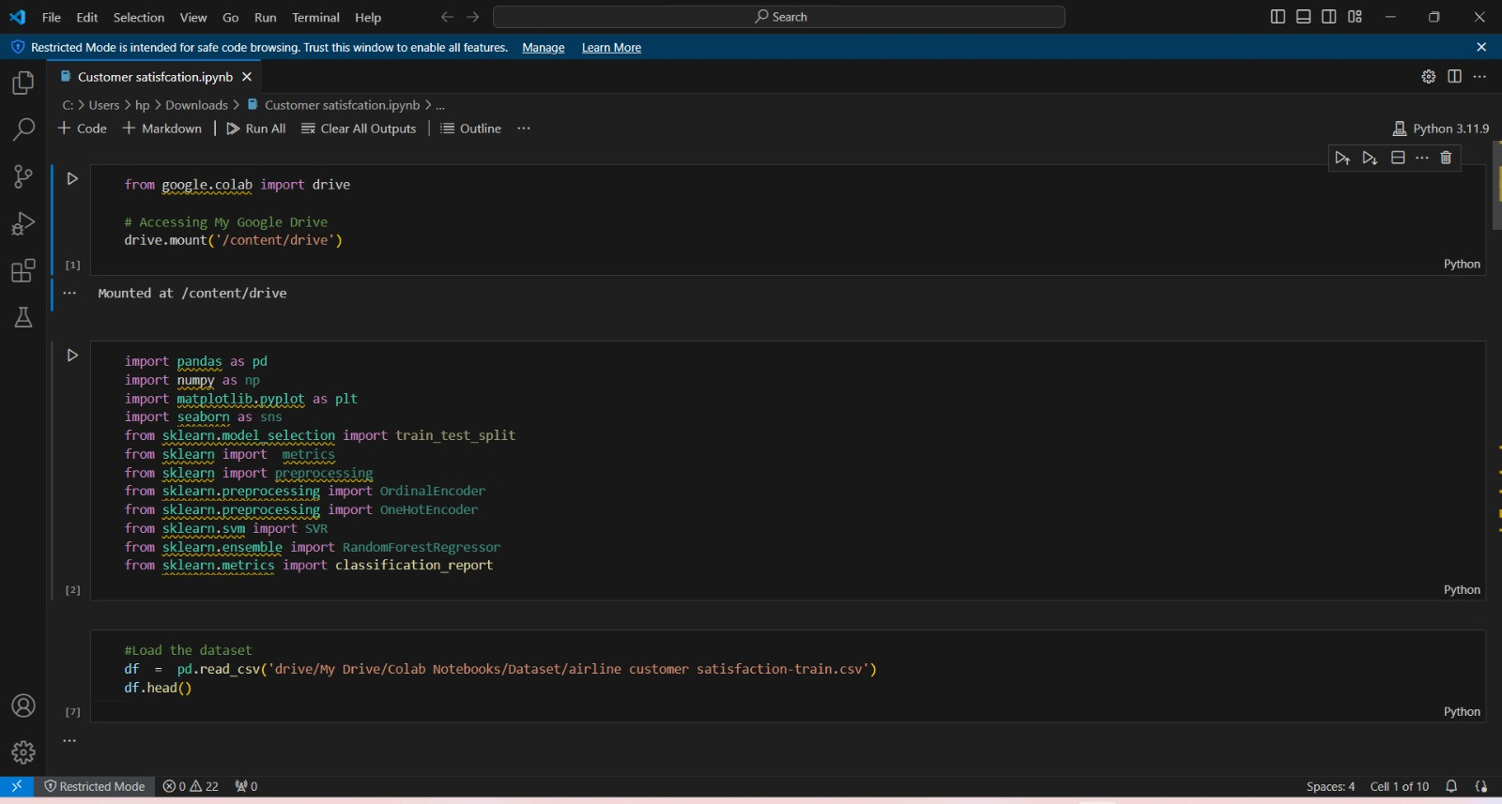
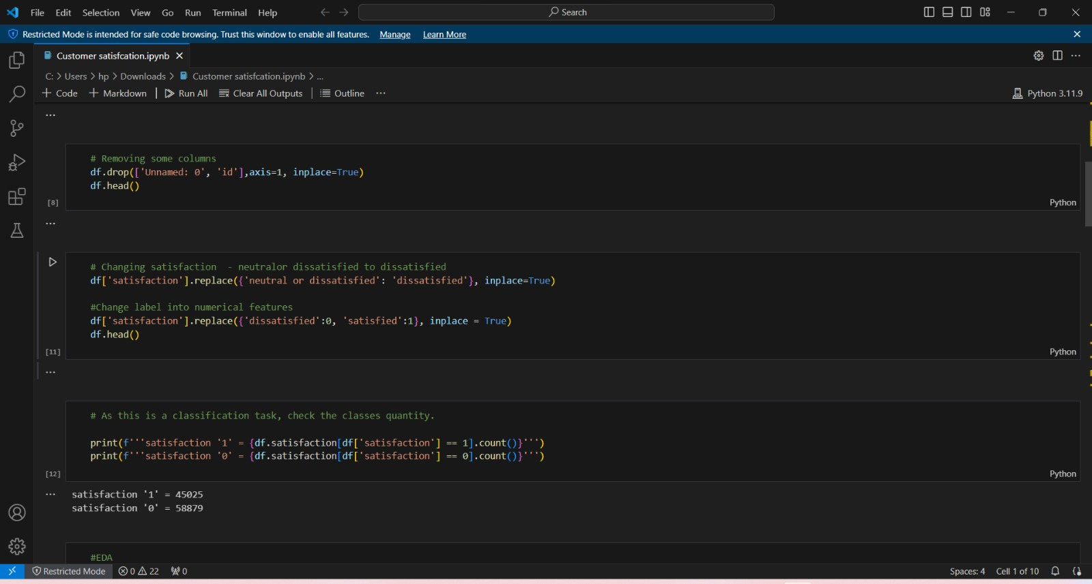
Result

Slide 9
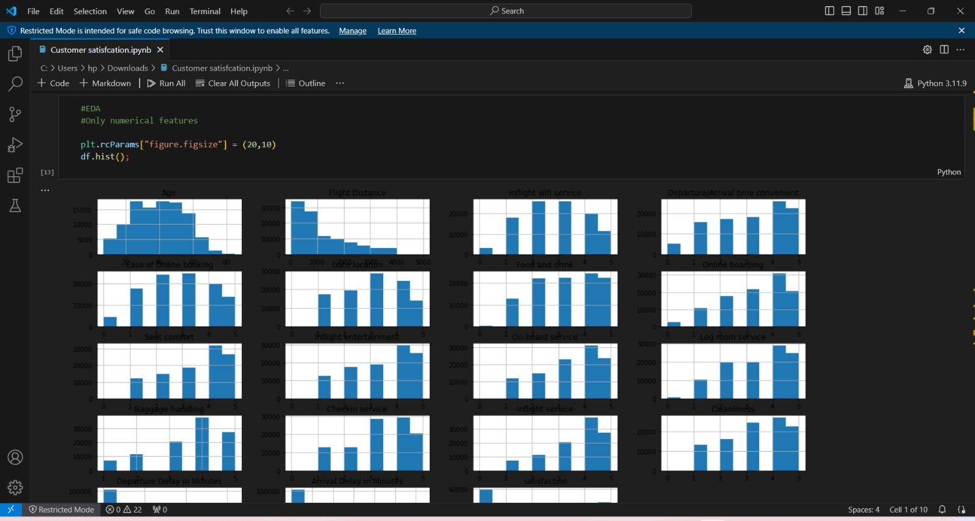
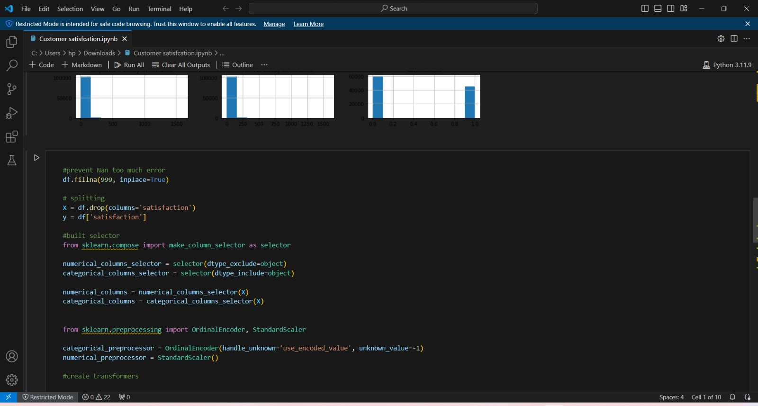

Slide 10
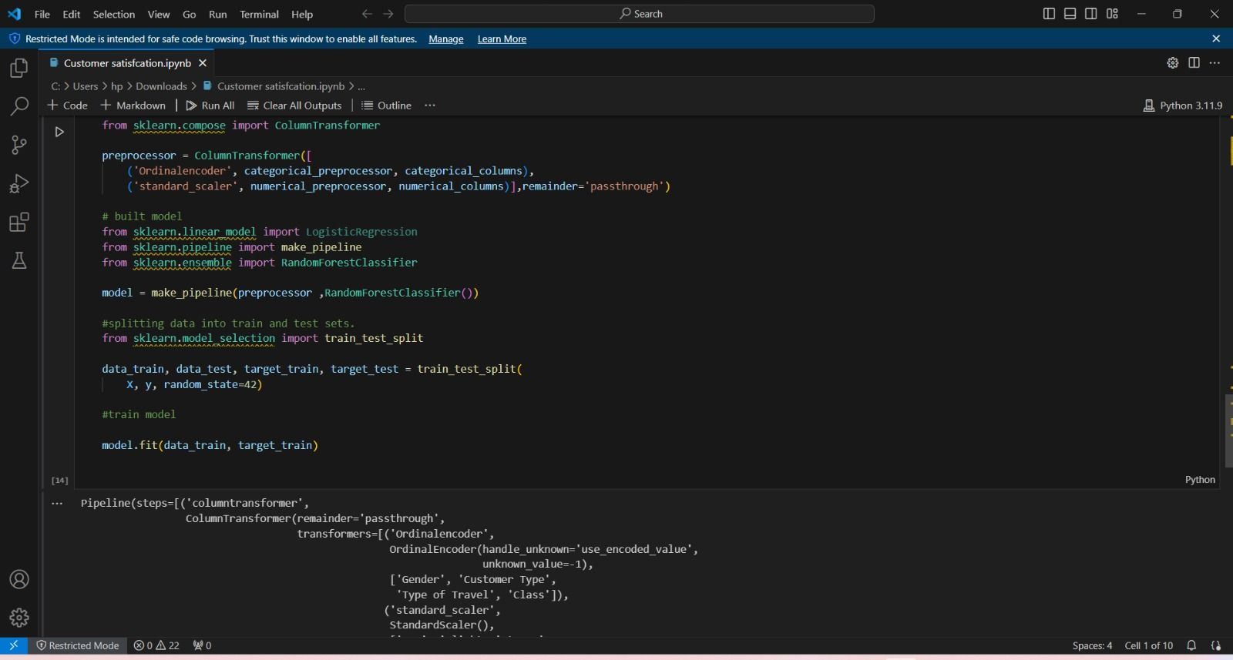
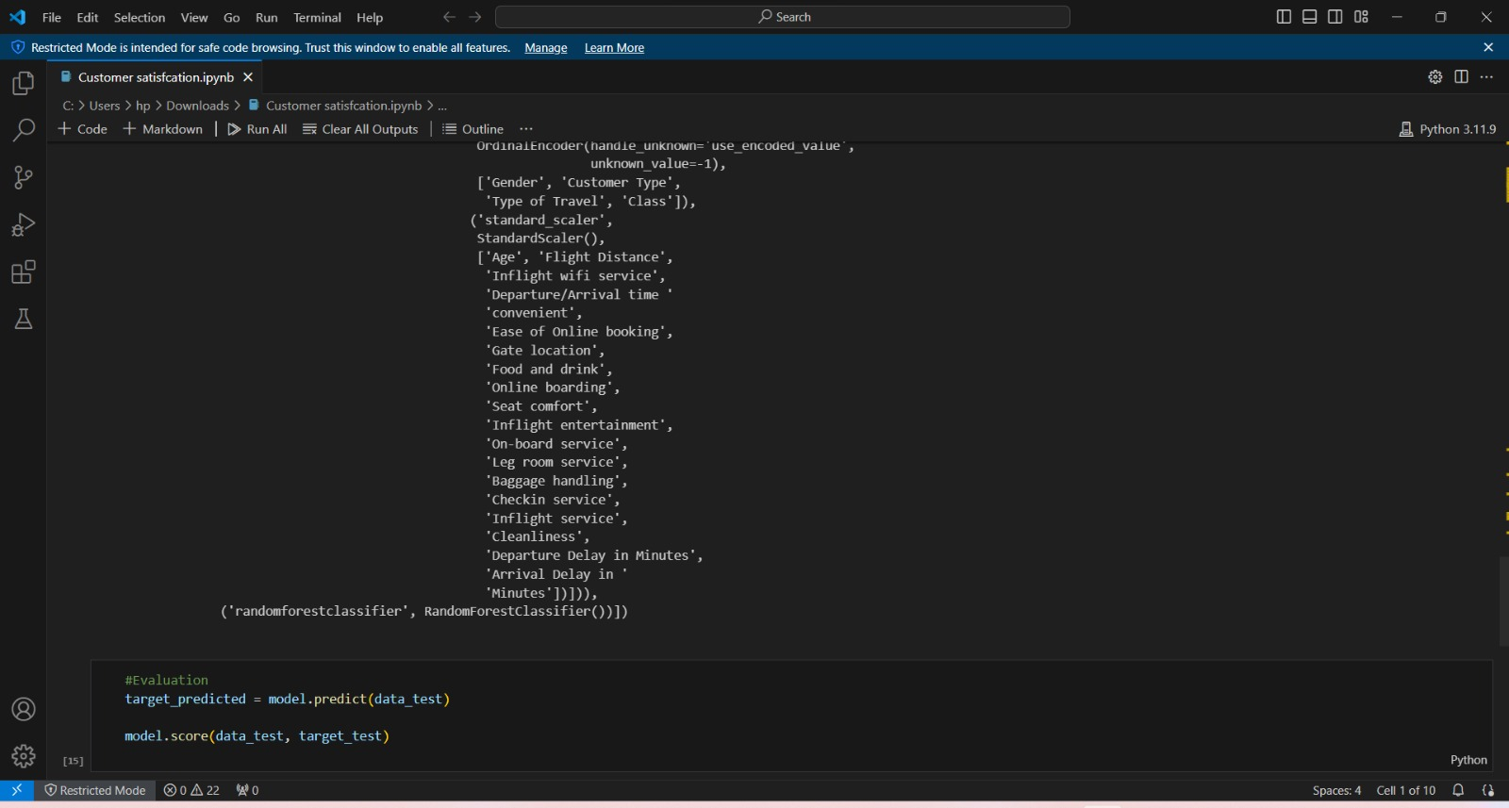

Slide 11
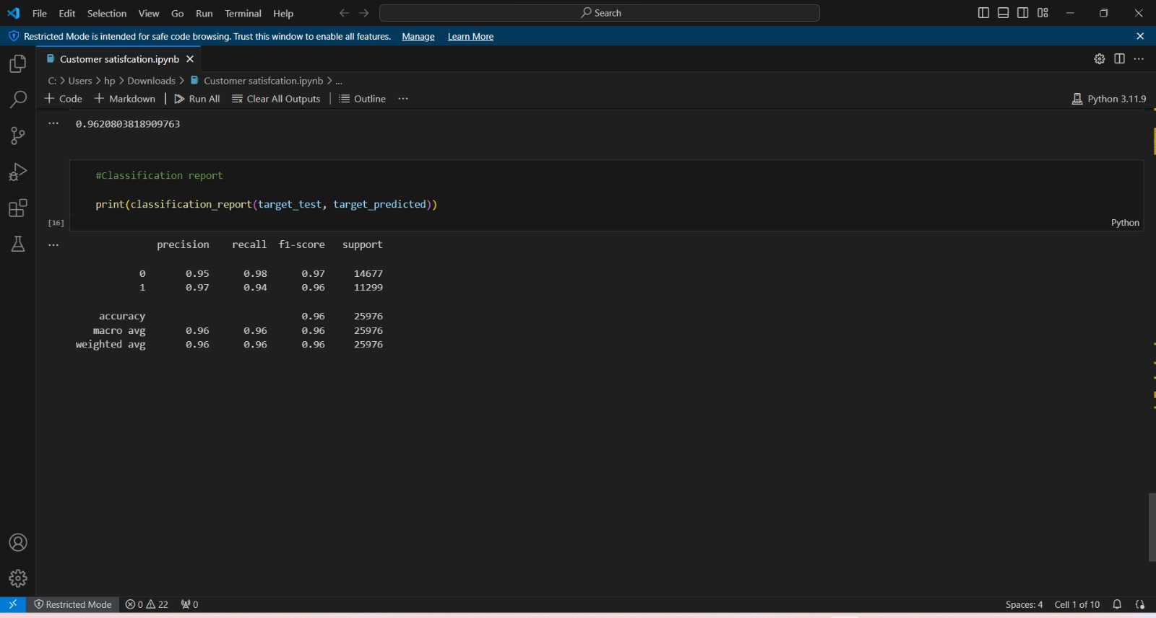

Slide 12
Conclusion
Customer satisfaction is the cornerstone of a thriving business, driving customer loyalty, repeat business, and positive word-of-mouth recommendations. Companies that prioritize customer satisfaction can expect improved customer retention, reduced churn, and increased revenue.
Achieving high levels of customer satisfaction requires a comprehensive approach that addresses various factors, including customer service, product quality, operational efficiency, and customer engagement. Businesses should adopt a customer-centric mindset, recognizing that each interaction with a customer contributes to their overall experience.
This requires a coordinated effort across departments, including sales, marketing, customer support, and operations. A system approach that integrates technology, cross-functional collaboration, and continuous improvement can lead to sustained customer satisfaction.
Algorithmic and data-driven approaches can further enhance customer satisfaction by providing insights into customer behavior and enabling predictive analytics

Slide 13
Future scope
Artificial Intelligence and Automation: The role of artificial intelligence (AI) in customer satisfaction is poised to grow. AI-driven chatbots, virtual assistants, and automated customer support systems can offer instant responses and personalized interactions, improving response times and reducing workload on human support teams. Automation can streamline repetitive tasks, allowing customer service agents to focus on more complex customer issues. This can lead to improved efficiency and customer satisfaction.
Predictive Analytics and Personalization: Predictive analytics will become increasingly important in anticipating customer needs. Businesses can use machine learning algorithms to predict customer behavior, allowing for proactive engagement and tailored recommendations. Personalization, driven by data analytics, will be a key differentiator. Companies can create customized experiences based on individual customer preferences, purchase history, and behavior patterns.
Omnichannel Customer Experience: Customers are engaging with businesses across multiple channels, including online, in-store, social media, and mobile apps. The future scope includes creating a seamless omnichannel experience where customers can transition between channels without losing continuity. Companies will need to invest in integrated systems that ensure consistent information and service quality across all touchpoints.
Customer Feedback and Sentiment Analysis: As customer feedback becomes more diversified, with customers providing input through various platforms, sentiment analysis tools will play a crucial role in understanding customer emotions and trends

Slide 14
References
Academic Literature and Journals: Journals such as the "Journal of Marketing," "Journal of Consumer Research," and "Journal of Service Research" often publish studies and papers on customer satisfaction, consumer behavior, and marketing strategies.
Business Books: Books focused on customer experience and satisfaction can offer comprehensive insights and case studies. Popular titles include "The Customer Experience Book" by Alan Pennington and "Delivering Happiness" by Tony Hsieh.
Industry Reports: Industry reports from consulting firms like McKinsey, Bain & Company, and Deloitte provide detailed analysis on customer satisfaction trends, key performance indicators, and best practices. Reports from research firms like Forrester and Gartner also offer valuable insights.
Customer Satisfaction Frameworks: Frameworks such as the Net Promoter Score (NPS), Customer Satisfaction Index (CSI), and Customer Effort Score (CES) are widely used to measure and analyze customer satisfaction.
Customer Feedback Platforms: Platforms like Trustpilot, Yelp, and Google Reviews provide real-time feedback and insights into customer satisfaction, allowing businesses to understand customer opinions and trends.
Online Articles and Blogs: Business websites like Harvard Business Review, Forbes, and Inc. often feature articles and blogs on customer satisfaction, offering practical tips and real-world examples

Slide 15
THANK YOU

